Slide 1



z
November 15
Update
The attack of the tensors

Slide 2

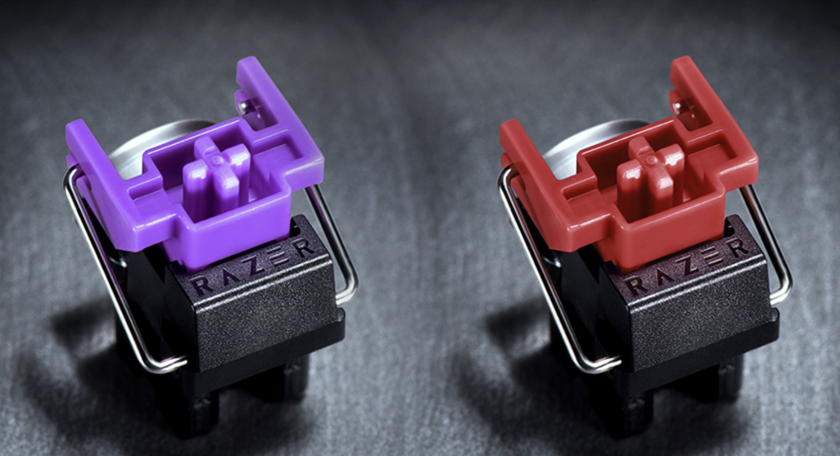
Switches and Interferometer Questions
- I forgot optical switches are also a computer thing
- too bad my gaming days are over
- there are a lot of nanosecond switches, is there something specific I should avoid other than loss
- also do I have to take … like… the interferometer into account?
- based off what I found I am assuming no, but I’d rather ask

Slide 3
Papers
- I found another(!) paper written by the person(s) who did the boson sampling paper ! !
- I’ve been looking at the tensor networks stuff, it (kind of) makes (some) sense
- I think I really need to know how the tensor networks work, it seems…. Really relevant ‘
- like really relevant
- I watched a few videos on this … working on it

Slide 4
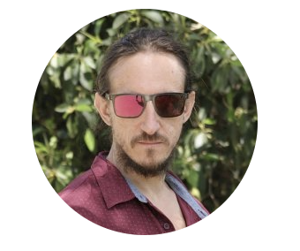
Implementing Scalable Boson Sampling with Time-Bin Encoding: Analysis of Loss, Mode Mismatch, and Time Jitter
- The guyTM made another (really good) paper
- It talks a lot about the mathematical implementations
- Talks a lot about loss
- actually hes made so many good papers (hes cracked):
- an introduction to boson sampling(goes over v e r y basic math)
The guyTM

Slide 5
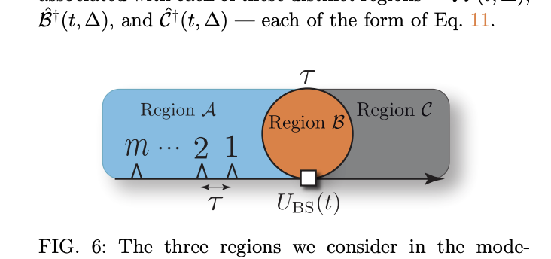
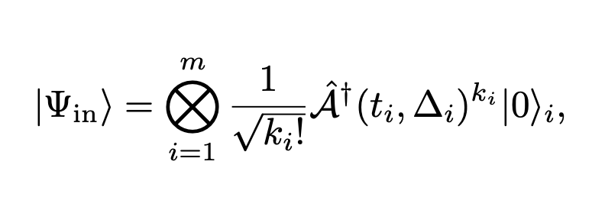
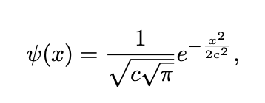
Implementing Scalable Boson Sampling with Time-Bin Encoding: Analysis of Loss, Mode Mismatch, and Time Jitter
- The paper has a lot of different models to show how the system acts at different times

Slide 6
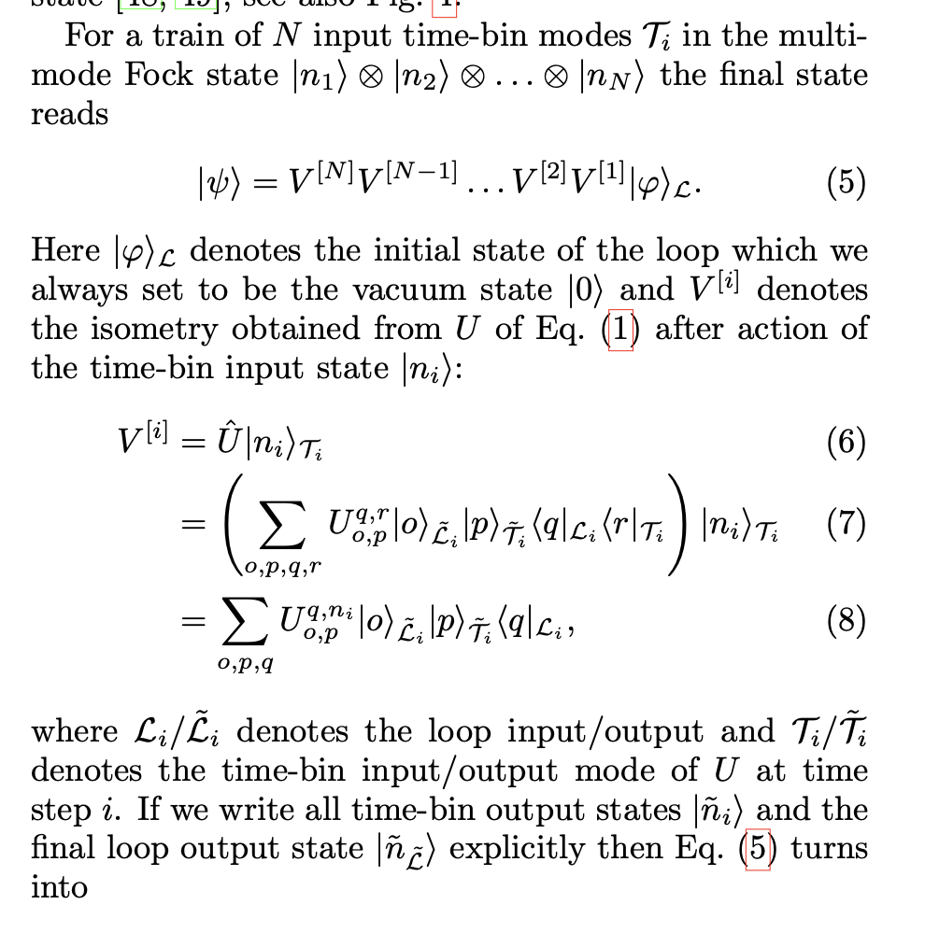
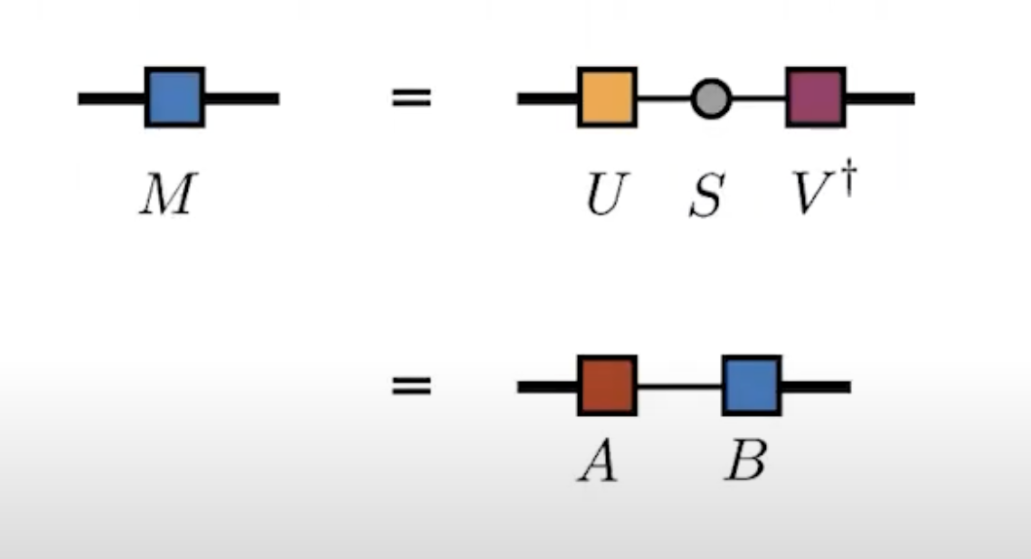
The 2 ways I’m trying to do it
- I’m lost on notation , been watching so many videos
- Everyone (?) hates the notation, they are literally using pictures to talk about this
1. Tensor Networks
Those are literally boxes and lines

Slide 7
Tensor Networks Continues
Ok but then why:
- if I can figure this out it seems like it would be better to use
- I want to see if I can just simulate one loop and then add the other one (like break it into chunks I guess)
- why do I want to do this : Idk a lot of papers I’ve seen are using tensor networks as well now (at least for quantum computing applications) so it seems…. Relevant

Slide 8
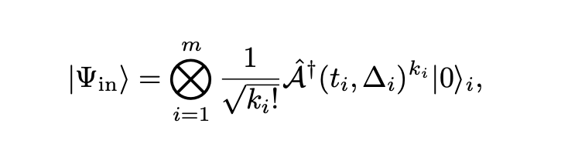
The 2 ways I’m trying to do it
- This is what I was originally thinking but hey its also all tensors
- It seems like a good idea to split it up like this anyway
- Not entirely sure how to add the switches in…
2. The GuyTM way

